Slide 1
MCA Major Project Mid Term Evaluation
NextGen
Under the guidance of
Dr. Pradeep Kumar
Department of Computer Applications
Faculty of Science, Technology and Architecture
Manipal University Jaipur
By
Vaibhav Sharma
23FS20MCA00001
2023-25

Slide 2
Outline
Introduction
Motivation
Process Model
Software Requirement Specification (SRS)
Data Flow Diagram (DFD)
Output
Conclusion
Future Scope

Slide 3
Introduction
NextGen is a modern online education system designed to connect learners with superior academic instruction. In today’s rapidly evolving virtual sphere, gaining fresh talents and remaining current is now crucial . NextGen provides an interactive, captivating, and approachable educational experience for students, experts, and people committed to continuous learning. NextGen uses new technology to give you a smooth way to learn online. It is interactive, can fit into your schedule, and it is made to suit your study style. With an extensive variety of classes across different fields, individuals have the freedom to acquire knowledge individually and in the privacy of their residences. NextGen is designed to be an expandable, fortified, and fast e-learning hub by using modern Java-based backend systems and a versatile React.js user interface. Our technology provides a smooth learning journey, immediate connection, and organized material for both students and teachers. The starting part of NextGen is made with React.js. This helps in making a great and quick workplace for users. With a component-based architecture, it ensures flexibility, reusability, and faster load times. The user interface, also, employs Redux for managing data states to manage live data changes effectively. Tailwind CSS improves the UI with contemporary and sleek designs, and Progressive Web App (PWA) compatibility guarantees a smooth mobile learning journey on various devices. NextGen shines because of its cloud setup, instant chats, AI-guided learning paths, and tight user security. Its backend runs on small separate services, suggests smart course choices, and works on many devices. This means it can grow while still working well. Down the road, they plan to add a mobile app, make learning more like a game, and use AI to tailor the experience even more. These changes aim to make learning more fun and useful.

Slide 4
Motivation
Education serves as the cornerstone of development; however, numerous students face challenges in obtaining quality learning materials due to financial constraints, geographical limitations, or inflexible timetables. NextGen aims to eliminate these obstacles by offering a flexible, cost-effective, and stimulating educational experience accessible to all, at any time and from any location. Learning forms the basis for personal development, but many students find it hard to get their hands on top-notch educational materials. This can happen because of high costs where they live, or strict timetables. NextGen aims to knock down these obstacles. It offers a learning experience that bends to your needs, doesn't break the bank, and keeps you hooked. You can tap into this resource whenever you want, no matter where you are. Educators and instructors frequently encounter difficulties in expanding their audience, generating revenue from their content, and effectively managing their courses. NextGen offers a robust platform for course creators, allowing them to concentrate on teaching as we take care of payment processing, student interaction, and content distribution. A significant shortcoming observed in numerous e-learning platforms is the absence of real-time interaction between students and instructors. NextGen addresses this deficiency by offering live classes, discussion forums, and interactive functionalities, thereby fostering an environment conducive to collaboration, inquiry, and prompt feedback for students. Our objective is to enable both learners and educators by leveraging technology, facilitating seamless, interactive, and fulfilling knowledge exchange. By providing appropriate tools, support, and cutting-edge educational approaches, NextGen aspires to transform the delivery and consumption of education.

Slide 5
Process Model
1. Requirement Analysis & Planning
Identify the core features (User roles, Course management, Payments, AI-based recommendations).
Define the technology stack: React.js (Frontend), Spring Boot (Backend), MySQL (Database), AWS (Deployment)
Establish clear milestones for development.
2. System Design
Frontend Design: UI/UX wireframes for the student, instructor, and admin panels.
Backend Architecture:
REST APIs for authentication, course management, payments.
Secure role-based access with Spring Security & JWT.
Database Schema: Design MySQL tables for Users, Courses, Payments, Enrolments, and Progress Tracking.
3. Development Phase
Week 1: Project Setup
Initialize React.js project with Vite.
Set up Spring Boot with MySQL.
Implement authentication using JWT & OAuth2.

Slide 6
Process Model
Week 2: User & Course Management
Define user roles: Admin, Instructor, Student.
Develop CRUD APIs for managing courses.
Create course listing and enrollment features.
Week 3: Payment & Enrollment
Integrate Stripe/Razor pay for payments.
Implement one-time purchases & subscription models.
Develop instructor dashboard for revenue tracking.
Week 4: AI & Interactive Features
Implement AI-powered course recommendations.
Add progress tracking and live notifications.
Build discussion forums & real-time chat.
Week 5: Admin Panel & Security Enhancements
Develop an admin dashboard for course approval and user management.
Implement security features (Spring Security, OAuth, CSRF protection).

Slide 7
Process Model
Week 6: Testing & Deployment
Perform unit testing (Postman for API testing).
Optimize performance & security.
Deploy on AWS EC2, AWS RDS, CloudFront CDN.
4. Deployment & Maintenance
Frontend Deployment: Vercel/Netlify.
Backend Deployment: AWS EC2.
Database Hosting: AWS RDS.
Monitoring Tools: Prometheus, Grafana for performance tracking.

Slide 8
Software Requirement Specification
1. Tools and Technologies Used -:
Frontend: React.js, Tailwind CSS, React Router
Backend: Spring Boot, Spring Security, REST APIs
Database: MySQL (Hosted on AWS RDS)
Authentication: JWT, OAuth2 (Google Sign-In)
File Storage: AWS S3 (For course materials)
Payment Integration: Stripe/Razor pay
Hosting & Deployment: AWS EC2 (Backend), Vercel/Netlify (Frontend)
API Testing: Postman
Version Control: GitHub
2. Hardware Requirements -:
Processor: Intel Core i5 or higher
RAM: Minimum 8GB (16GB recommended for smooth development)
Storage: At least 50GB of free space
Operating System: Windows 10/11, macOS, or Linux (Ubuntu recommended)
Internet Connection: Stable broadband for development & deployment

Slide 9
Software Requirement Specification
3. Software Requirements -:
Development Environment: IntelliJ IDEA (Backend), VS Code (Frontend)
Java Development Kit (JDK): OpenJDK 17+
Node.js & npm: Latest LTS version
MySQL Server: MySQL 8.0+
Postman: For API testing
Git: Version control system for managing code
AWS CLI: To interact with AWS services
Docker (Optional): For containerized deployment

Slide 10
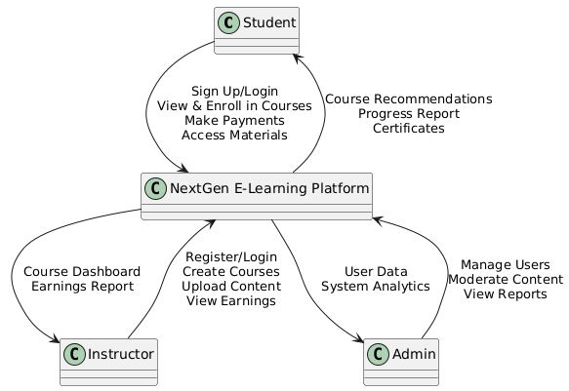
Data Flow Diagram

Slide 11
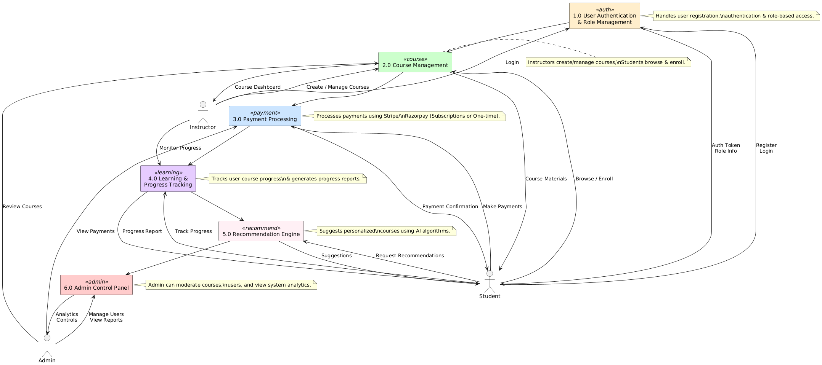
Data Flow Diagram

Slide 12
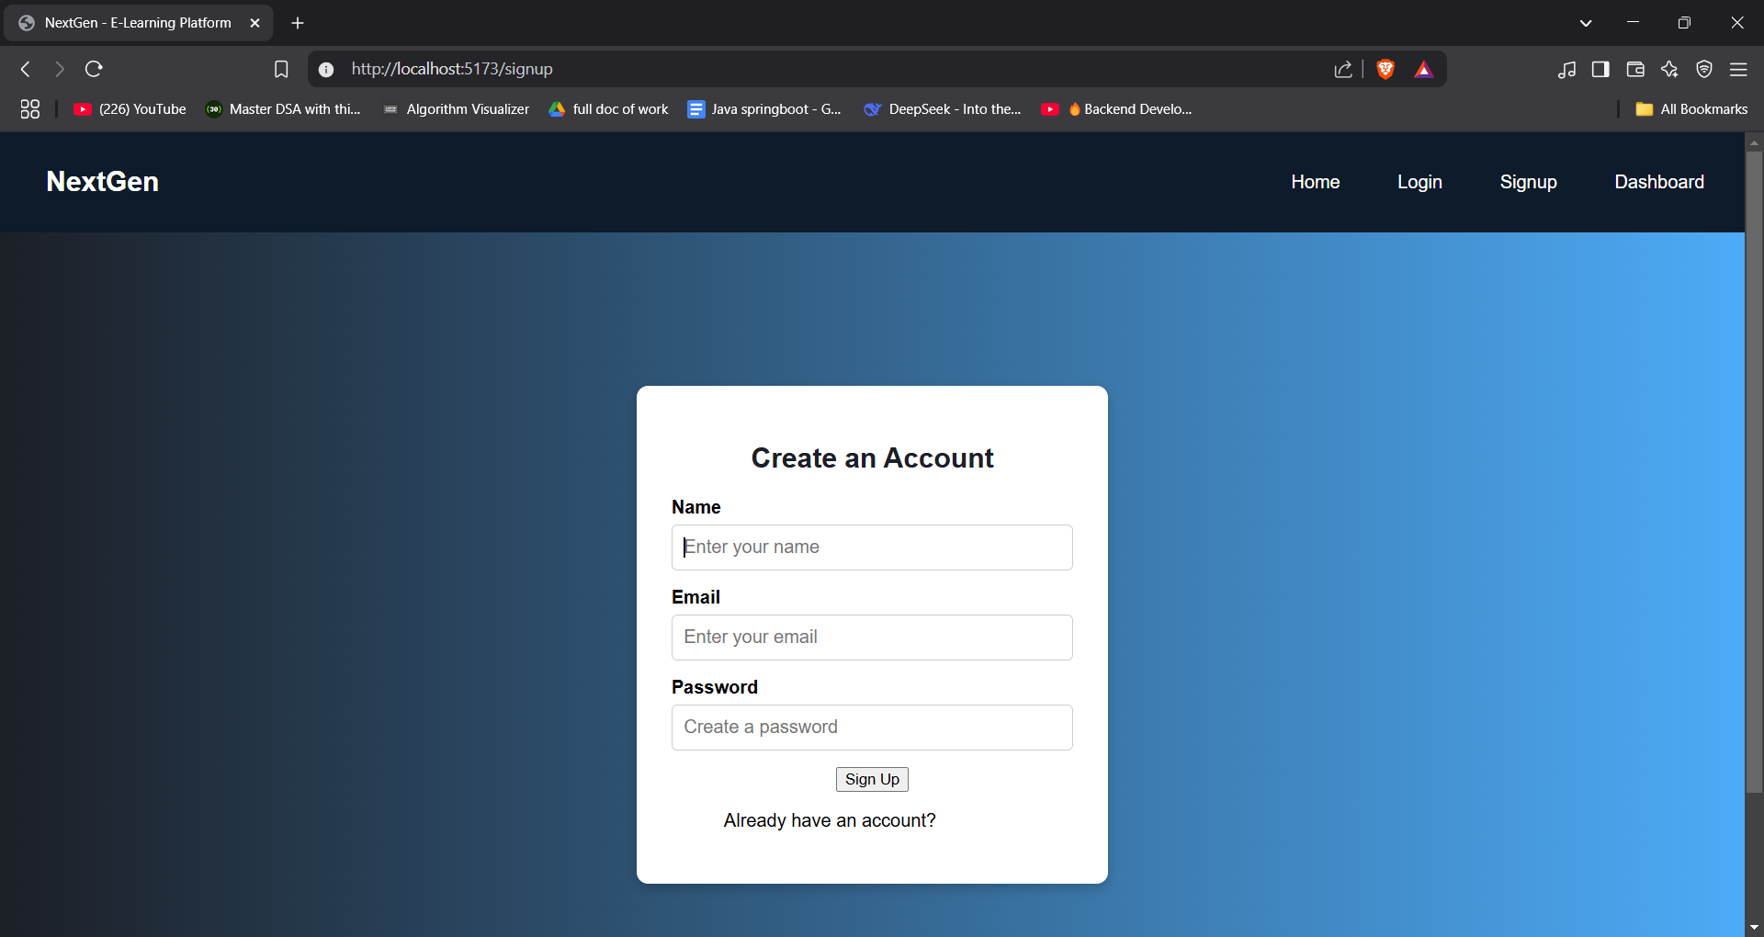
Output

Slide 13
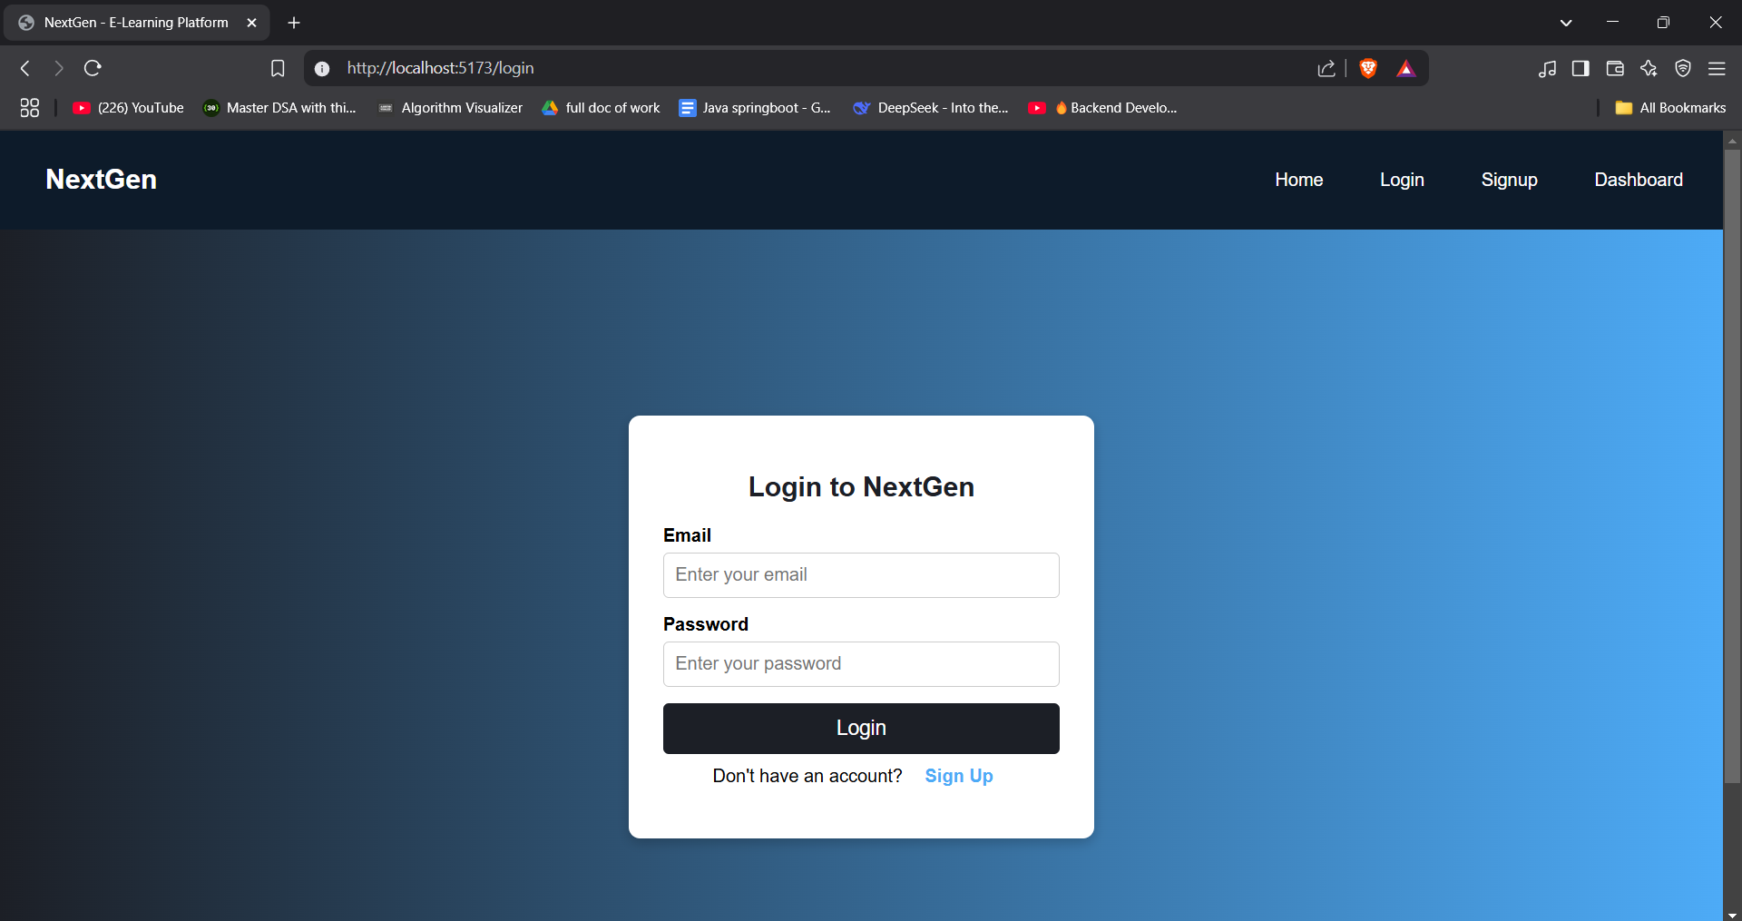
Output

Slide 14
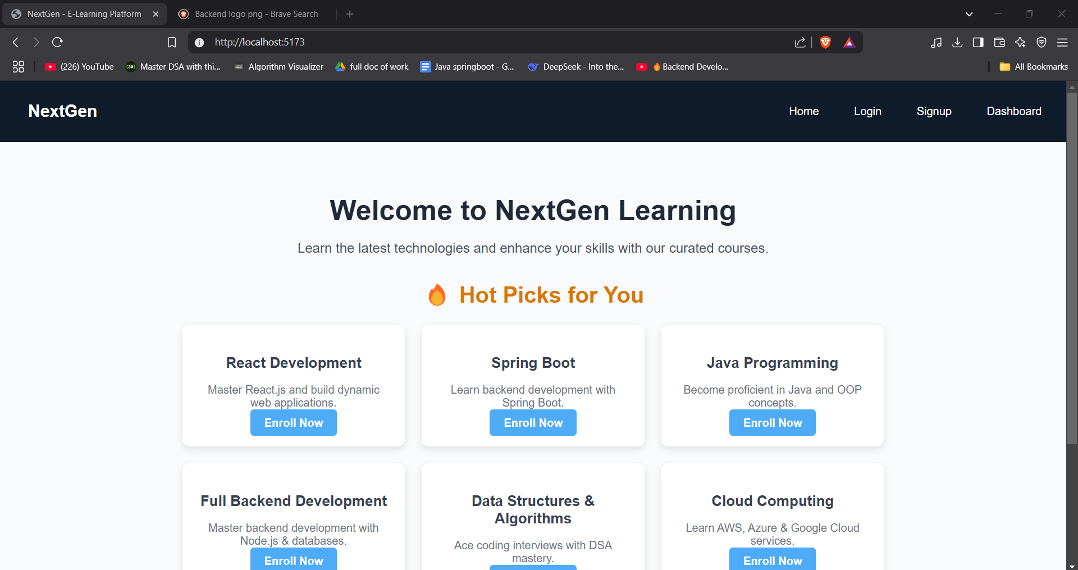
Output

Slide 15
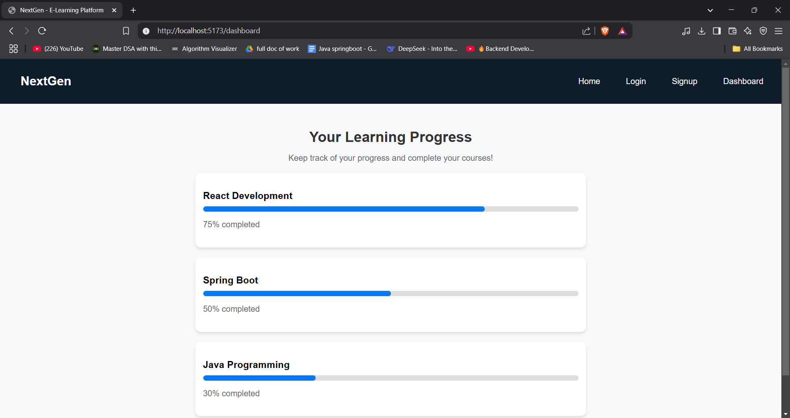
Output

Slide 16
Conclusion
NextGen is more than just an e-learning platform—it's a step toward making quality education accessible, engaging, and efficient. Through this project, we aimed to build a system where students can easily find and enroll in courses, instructors can share their knowledge effortlessly, and administrators can manage everything smoothly.
By using React.js for a fast and responsive frontend, Spring Boot for a secure and scalable backend, and MySQL for structured data management, we created a robust system that can handle real-world demands. Features like user authentication, course management, payments, and AI-based recommendations make this platform stand out.
Throughout the development process, we focused on ensuring security, performance, and ease of use. Deploying the project on AWS adds another layer of reliability and scalability, making it ready for future growth.
Looking ahead, there’s a lot of potential for improvement. Features like mobile app integration, gamification, and AI-driven learning paths can enhance the user experience even further. This project has been a great learning experience, and with continuous updates and improvements, NextGen has the potential to become a powerful tool in the world of online education.

Slide 17
Future Scope
The journey of NextGen doesn’t stop here—there are many ways this platform can grow and improve in the future. As online learning keeps evolving, we can add new features to make the experience even better for students and instructors.
Mobile App Development – A dedicated NextGen mobile app will make learning more accessible. Students can watch courses, track progress, and interact with instructors anytime, anywhere.
2. Live Classes & Webinars – Adding a live streaming feature will allow instructors to host real-time classes, Q&A sessions, and workshops, making learning more interactive.
3. AI-Powered Learning Paths – Using Artificial Intelligence, NextGen can suggest personalized learning paths based on a student's progress, interests, and performance. This will help students choose the right courses and stay on track.
4. Gamification for Engagement – Features like badges, leaderboards, and rewards can motivate students to complete courses and stay engaged.
5. Multilingual Support – Expanding NextGen to support multiple languages will help reach a global audience and make education accessible to non-English speakers.

Slide 18
Future Scope
6. Community & Discussion Forums – A dedicated forum where students can ask questions, discuss topics, and collaborate with peers will create a sense of community.
7. Enterprise & Corporate Training – NextGen can be expanded to offer customized training solutions for companies, helping businesses train employees through structured learning programs.
8. Integration with AR/VR – In the future, Augmented Reality (AR) and Virtual Reality (VR) can provide immersive learning experiences, especially for technical and hands-on courses.
With continuous updates and improvements, NextGen has the potential to become a leading e-learning platform. The future is bright, and as technology advances, this project can adapt and grow to meet the changing needs of learners worldwide.

